Slide 1
Flowchart & Introduction to LMS, VUES & AIUB website
Course Code: CSC 1101
Course Title: Introduction to Computer Studies
Dept. of Computer Science
Faculty of Science and Technology
Lecturer No: | 03 | Week No: |  | Semester:
Lecturer: | Name & email

Slide 2
Lecture Outline
List of topics,
Flow chart
IT Essentials-Chapter 2
Introduction to VUES and AIUB website
Introduction to Learning System Management

Slide 3
Specific Objectives
Will have a discussion on,
What is flowchart?
Basic symbols of flowchart
Flowchart rules
Developing flowchart
Advantages of flowchart
Introduction to VUES and AIUB website
What is Learning System Management(LMS)
Significance of LMS

Slide 4
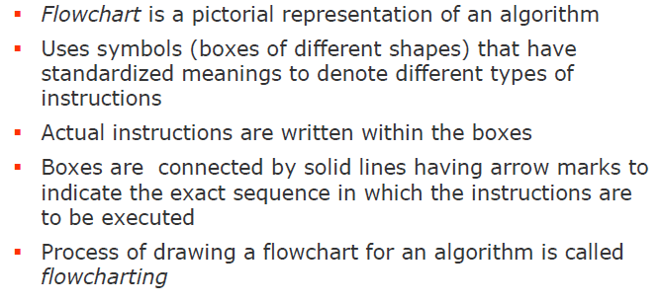
Flow Chart
What is flow chart?

Slide 5
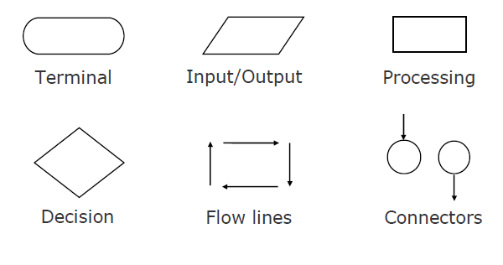
Flowchart
Basic flowchart symbols

Slide 6
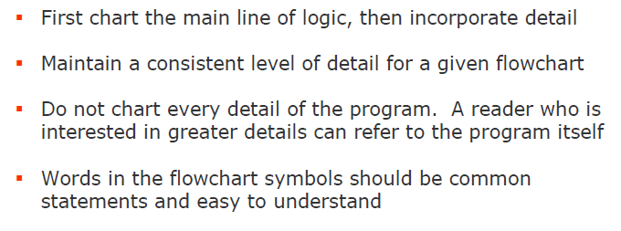
Flowchart
Rules

Slide 7
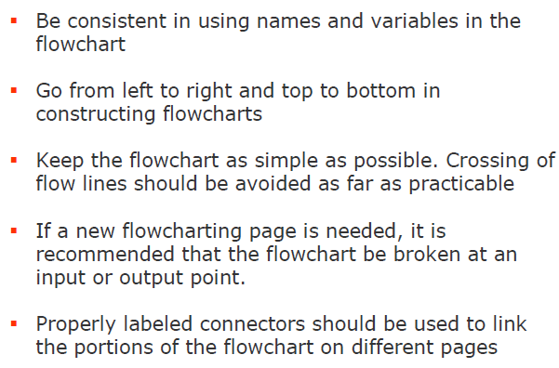
Flowchart
Rules

Slide 8
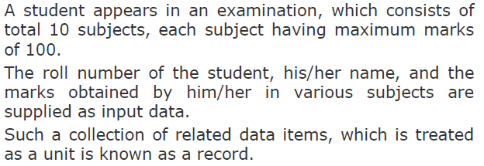
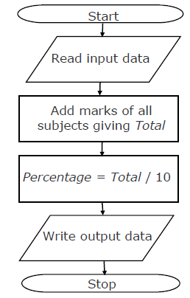
Flowchart
Example
Draw a flowchart to calculate the
Percentage marks obtained by the
Student in this examination and
Then to print it along with his/her
roll number and name

Slide 9
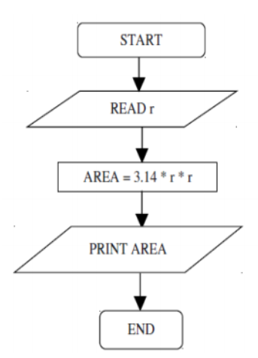
Flowchart
Example
Calculate the area of circle

Slide 10
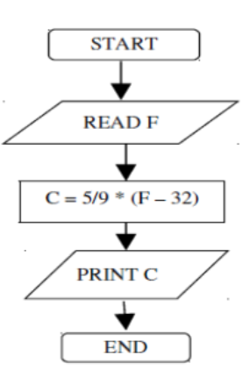
Flowchart
Example
Convert Fahrenheit to Celsius

Slide 11
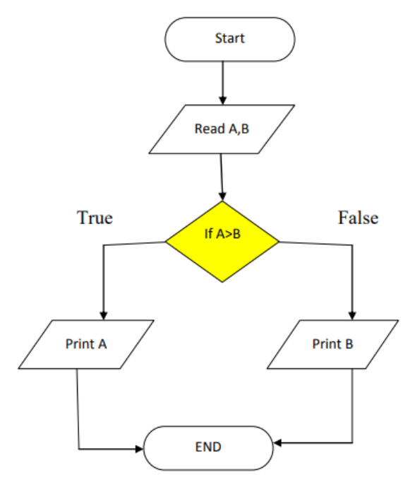
Flowchart
Example
Find the larger number

Slide 12
Flowchart
Significance of flowchart
Advantages of Flowchart-
Proper program documentation
Efficient Coding
Systematic testing
Systematic debugging
Better communication

Slide 13
IT Essentials
Chapter 2
The module is available on CISCO account.

Slide 14
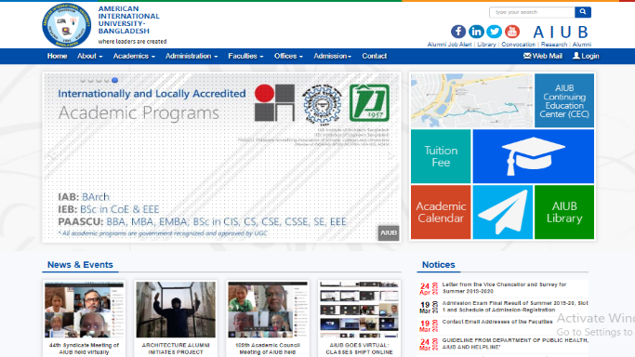
Introduction to AIUB website and VUES
AIUB website
Here is the link of AIUB official website, https://www.aiub.edu/

Slide 15
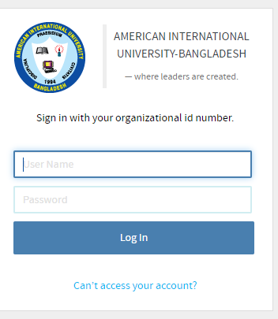
Introduction to AIUB website and VUES
VUES
VUES-Virtual University Expert System
Here is the link of sign-in page of AIUB Portal-
https://portal.aiub.edu/

Slide 16
Introduction to Learning Management System
Learning Management System is a Web-based application for-
Administration
Documentation
Delivery of educational course contents
Sharing information between individuals
Training programs

Slide 17
Introduction to Learning Management System
Learning Management Systems are being extensively used in schools, colleges, universities and in different kind of organizations.
Management of users, roles, courses, instructors, facilities and generating reports becomes easier.
LMS provides the flexibility to access it from their workplace or home. Authorized individuals have 24/7 access to this unique system through URL or through a unique User ID and Password.

Slide 18
Books & Links
http://www.yspuniversity.ac.in/cic/algorithm-manual.pdf
https://creately.com/blog/diagrams/flowchart-guide-flowchart-tutorial/
http://mycsvtunotes.weebly.com/uploads/1/0/1/7/10174835/computer_fundamental_complete-i.pdf

Slide 19
References
https://www.lynda.com/Moodle-tutorials/Introduction-learning-management-systems/578069/632144-4.html
https://www.gc-solutions.net/resources/articles/introduction-to-learning-management-systems.html

